Slide 1


ALTSCHOOL OF Cybersecurity (BARAKA 2025)
Week 3

Slide 2
REFRESHER - Week 2 (Major highlights)
HACKERS & TYPES
CIA TRIAD
CONSEQUENCES OF A SECURITY BREACH
SOME CYBERSECURITY ATTACKS
DENIAL OF SERVICE (DOS)
DISTRIBUTED DENIAL OF SERVICE (DDOS)

Slide 3
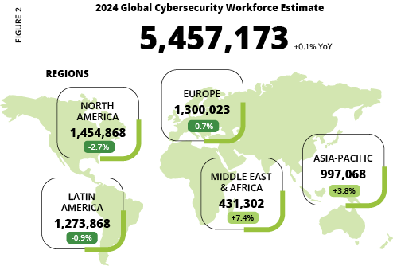
2024 GLOBAL CYBERSECURITY WORKFORCE

Slide 4
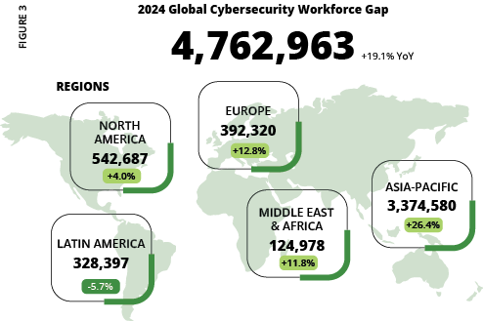
2024 GLOBAL CYBERSECURITY WORKFORCE

Slide 5
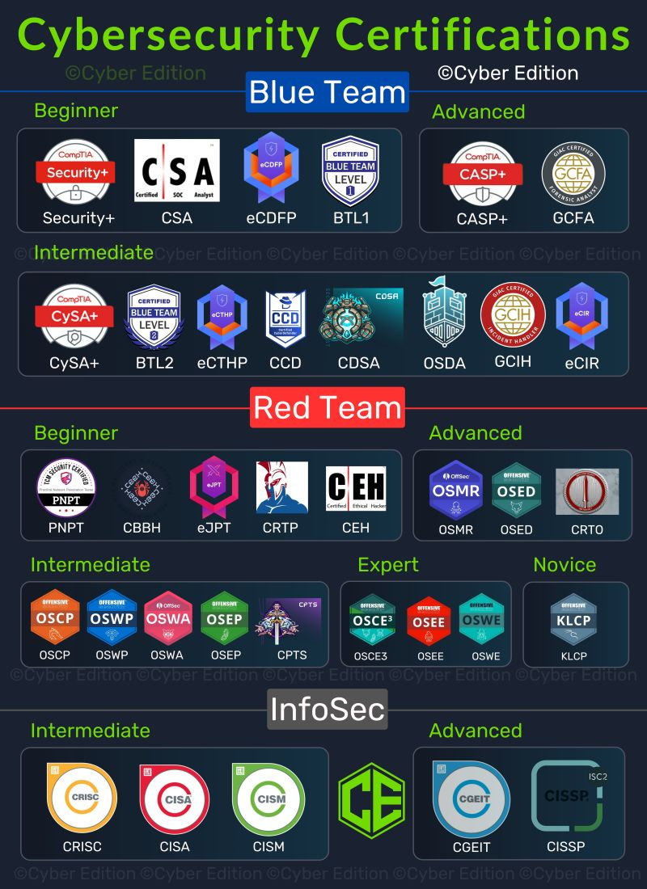
CYBERSECURITY CERTIFICATION PATH

Slide 6
Week 3 – DAY 1
FUNDAMENTALS OF SECURITY PRINCIPLES
DEFENSE IN DEPTH
LEAST PRIVILEDGE ZERO TRUST
SEPERATION/SEGREGATION OF DUTIES
SECURITY THROUGH OBSCRUITY
FAIL SAFE DEFAULTS
LABS: SOPHOS CENTRAL

Slide 7
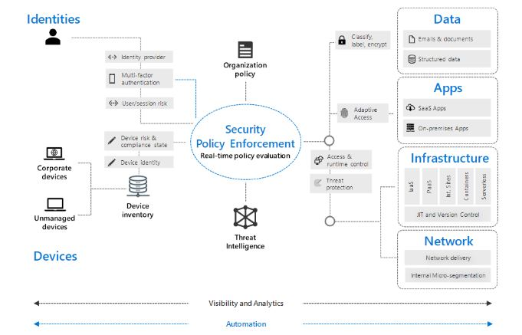
ZERO TRUST ARCHITECTURE

Slide 8
Defense In DEPTH

Slide 9
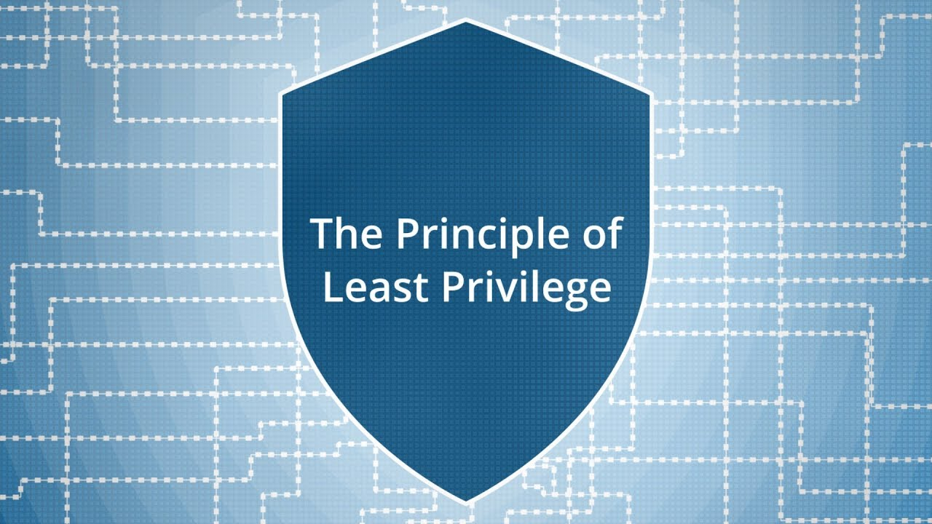
LEAST PRIVILEGE
Least Privilege refers to the access that is given to a user on a device or computer. Giving a user least privilege is to give a user account only the essential functions on the device needed to do their job. Giving a user least privilege helps protect individuals and companies from accidental disclosure of sensitive information, and sometimes the compromise of the computing environment users are operating within.

Slide 10
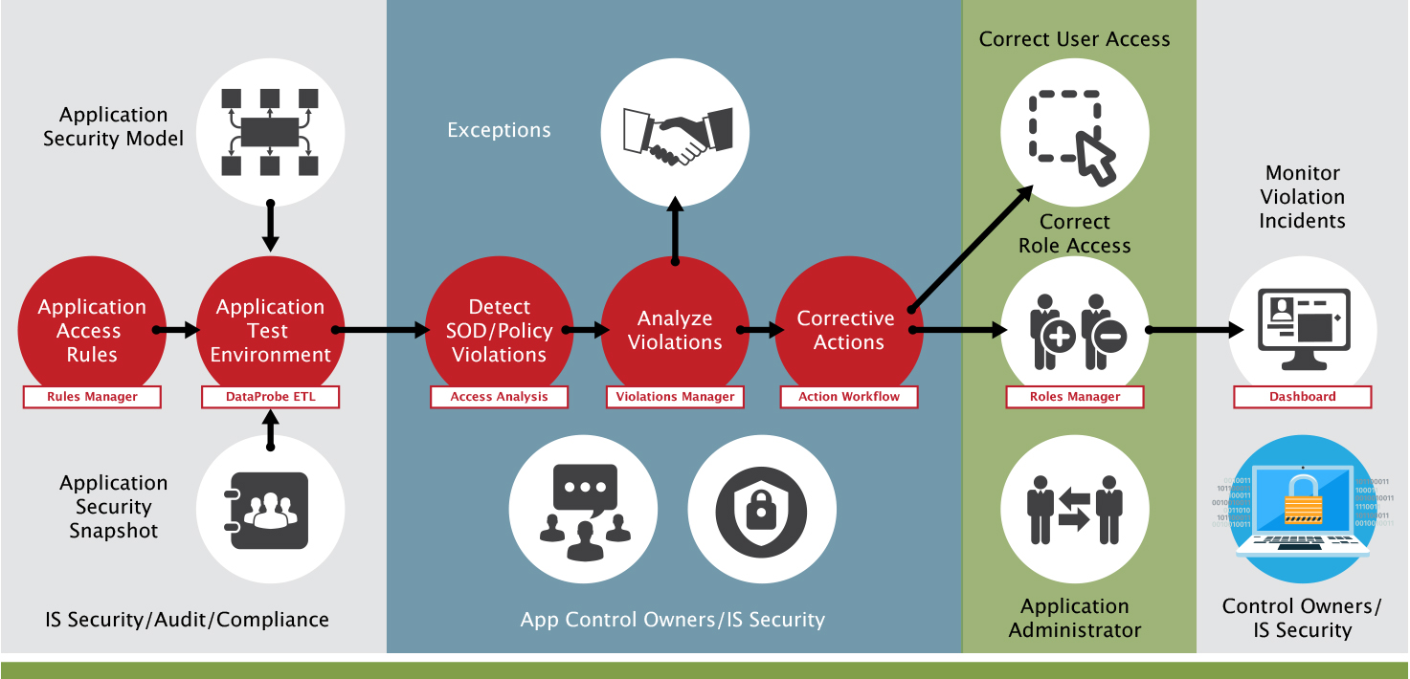
SEPARATION of duties
Separation of duties (SoD), also known as segregation of duties, is the concept of having more than one person required to complete a task. It is an administrative control used by organizations to prevent fraud, sabotage, theft, misuse of information, and other security compromises.

Slide 11
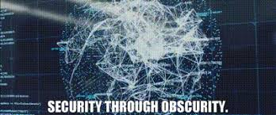
SECURITY THROUGH OBSCRUITY
Security through obscurity is a principle in cybersecurity where the security of a system relies on keeping its design, implementation, or mechanisms secret. Instead of using strong, well-tested security controls, the idea is that attackers will not be able to break into a system if they don’t know how it works.

Slide 12
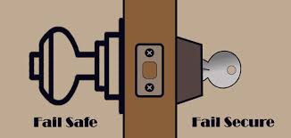
Fail safe defaults
Fail-Safe Defaults is a security principle that ensures access is denied by default unless explicitly granted. This means that systems and applications should start in a secure state, only allowing permissions that have been specifically approved.

Slide 13
LAB 1: SOPHOS CENTRAL
https://www.sophos.com/en-us/products/sophos-central/free-trial

Slide 14
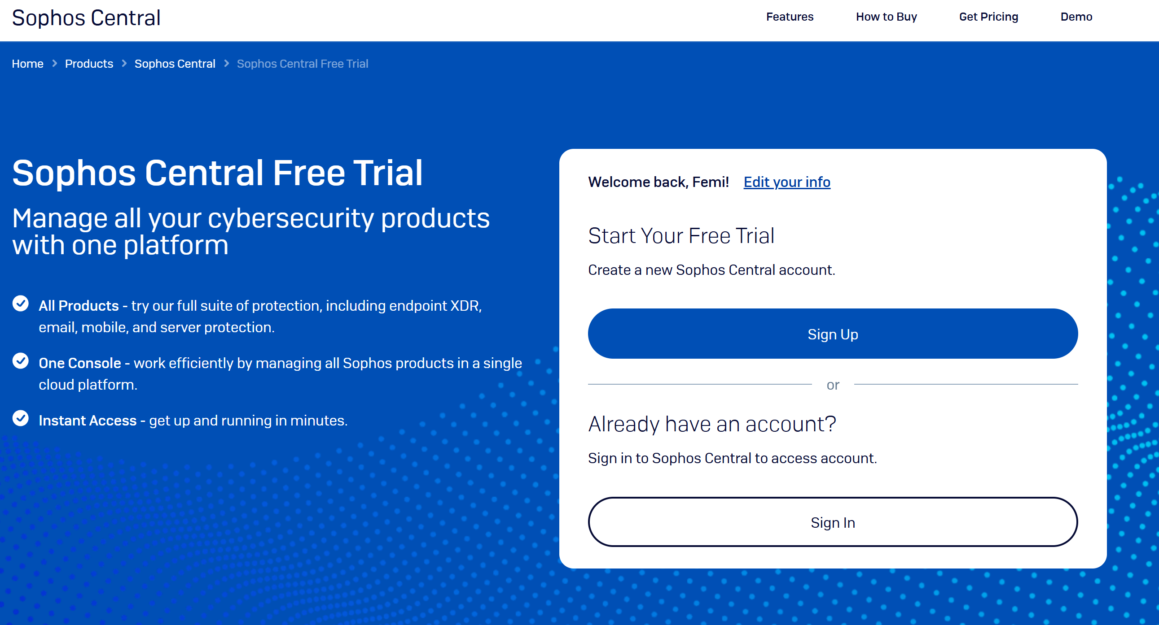
SIGN-UP TO SOPHOS CENTRAL

Slide 15
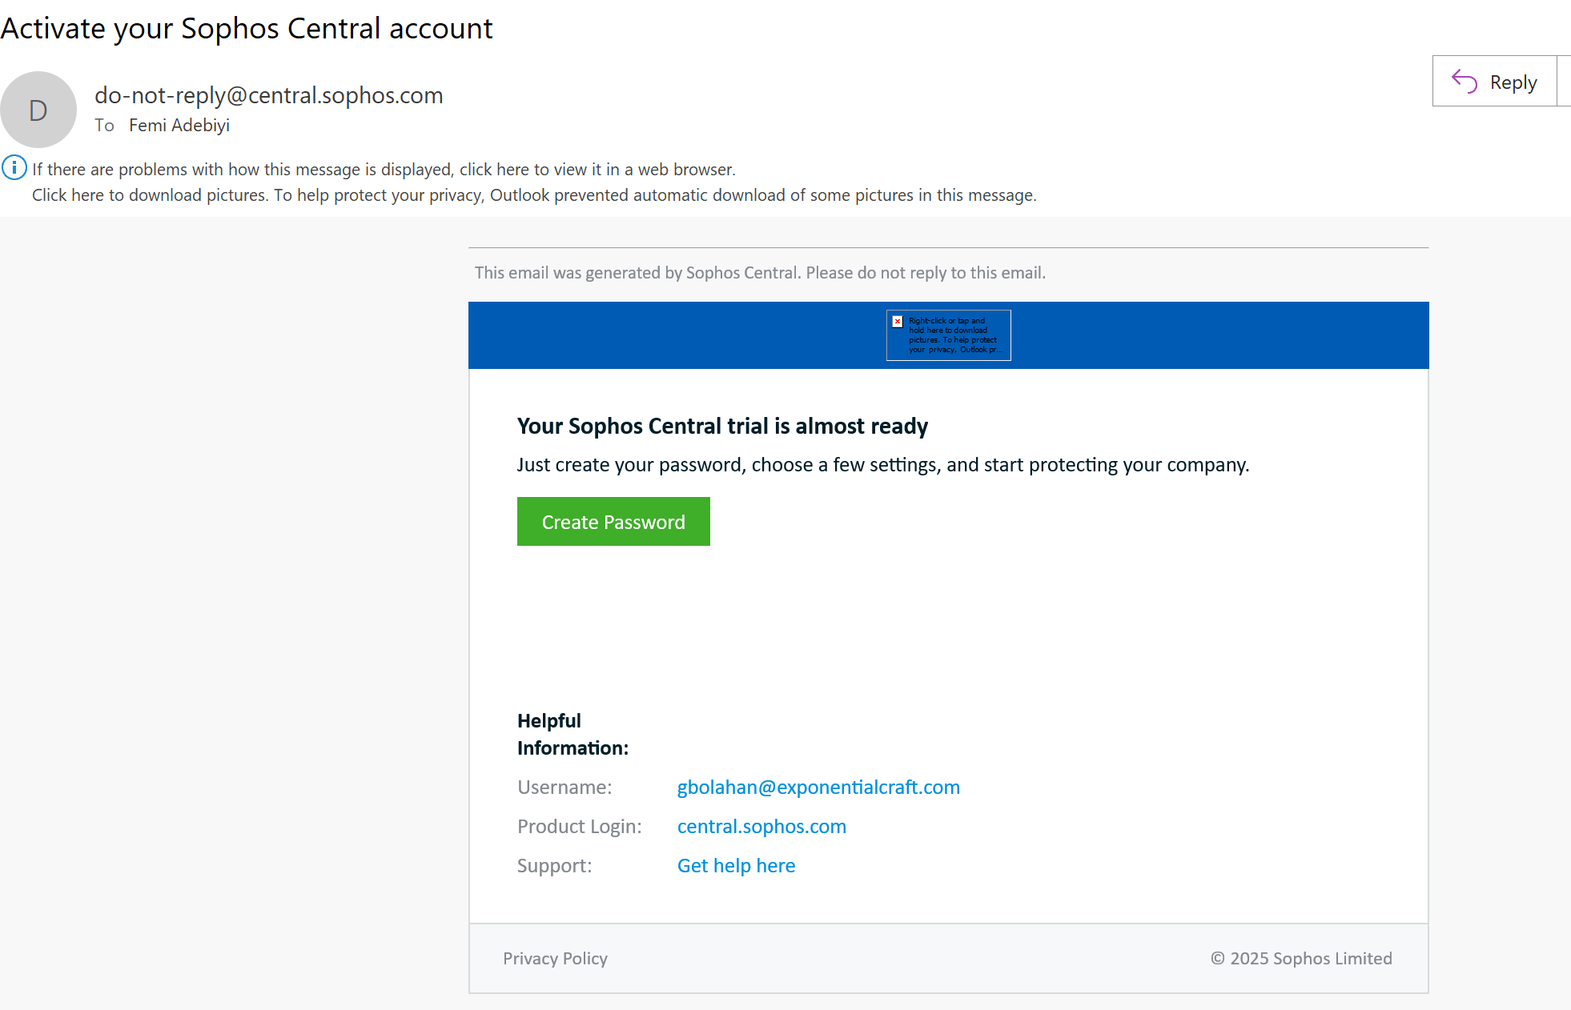
CHECK YOUR EMAIL AND CREATE A PASSWORD

Slide 16
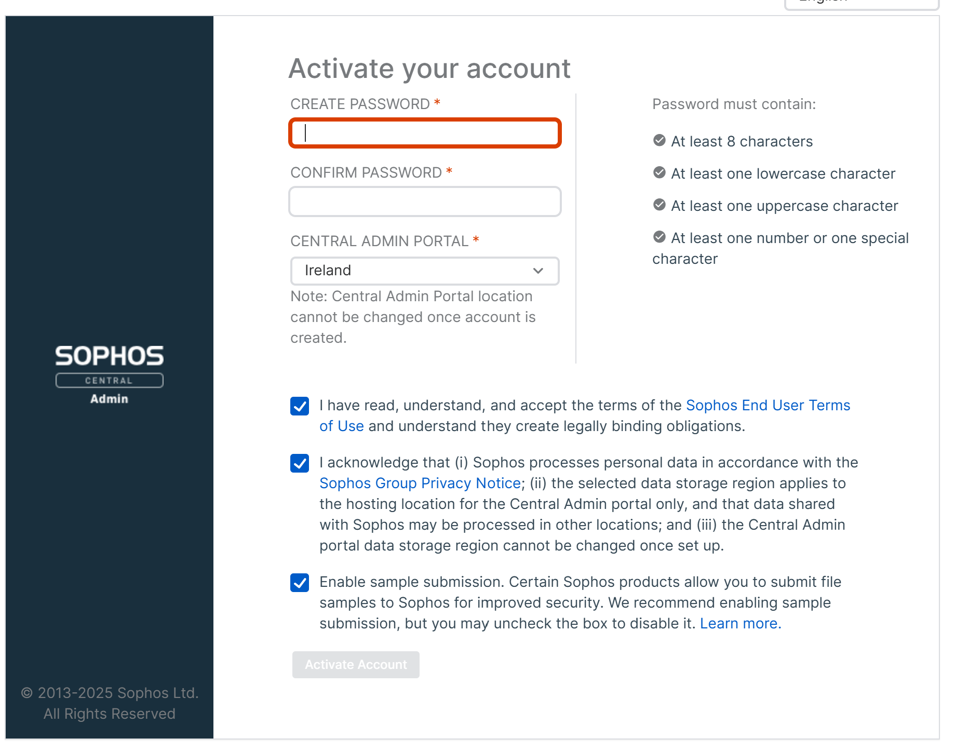
Proceed to create password and activate

Slide 17
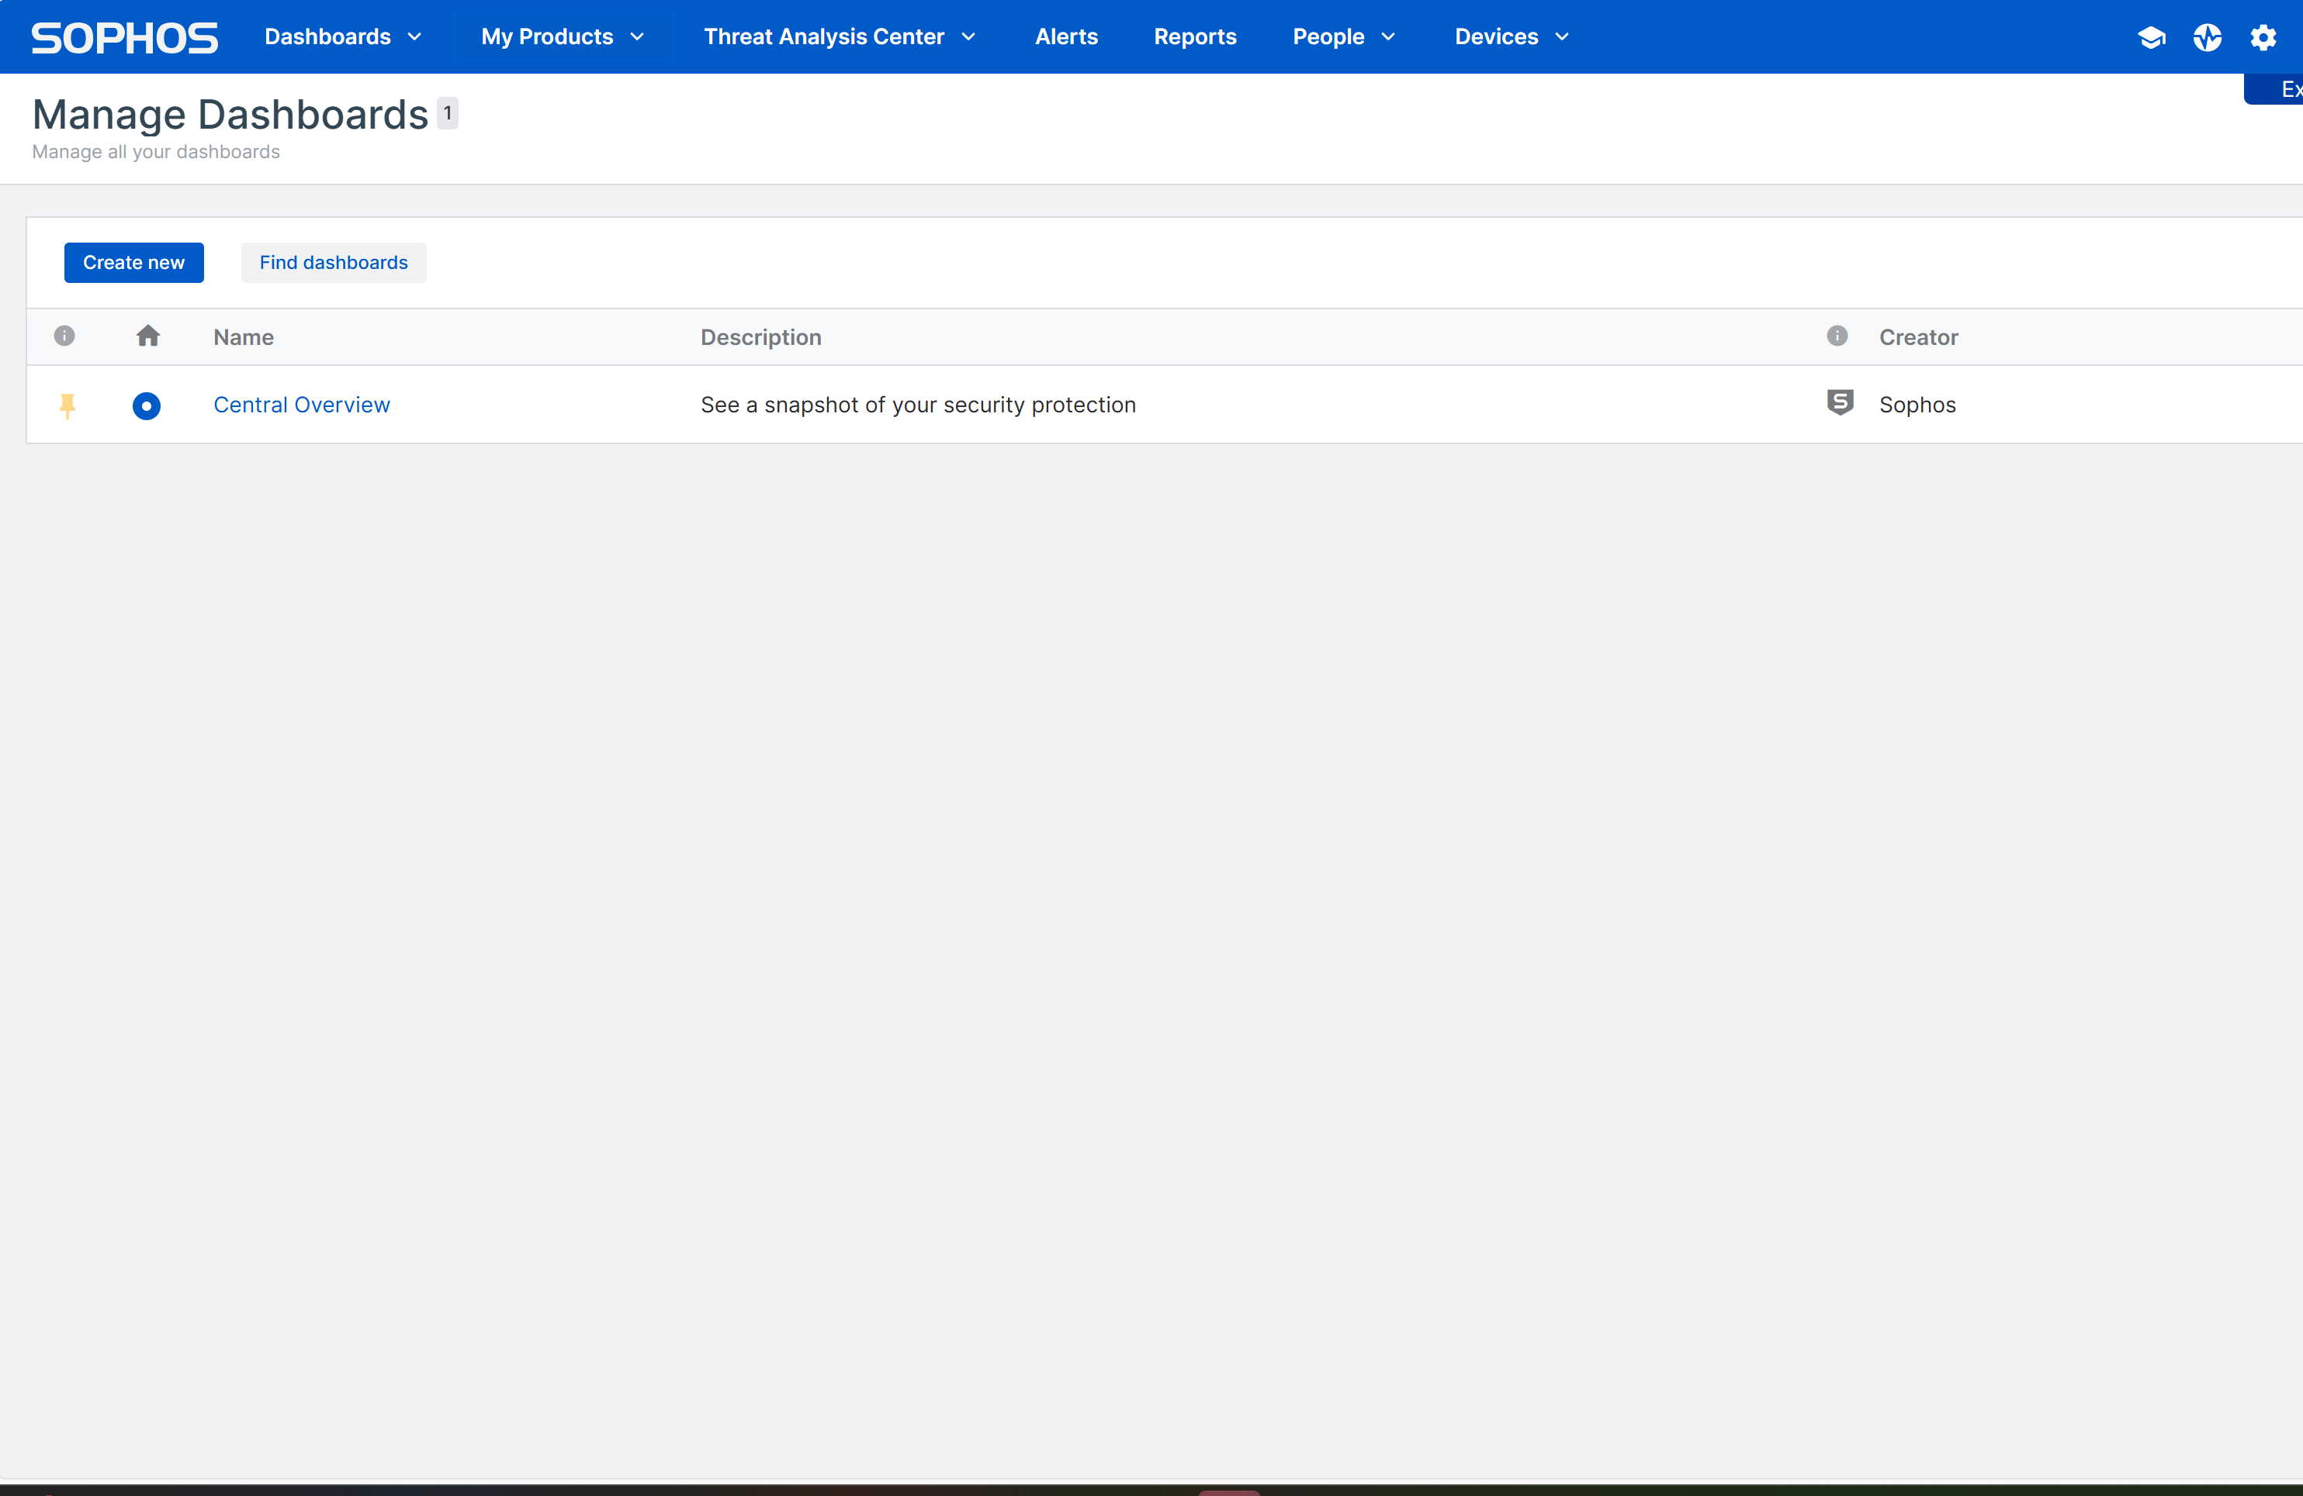
PROCCED TO SOPHOS CENTRAL DASHBOARD

Slide 18
Week 3 – DAY 2
RISK MANAGEMENT
IDENTIFYING AND ASSESSING RISKS
RISK MITIGATION STRATEGIES
RISK MANAGEMENT FRAMEWORKS (NIST, ISO)
LAB: VM ON AWS AND TENABLE

Slide 19
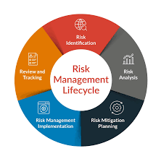
RISK MANAGEMENT
Risk management is the process of identifying, assessing, and mitigating risks that could impact an organization's objectives. It helps businesses minimize threats while maximizing opportunities.
In Cybersecurity security, risk management involves protecting systems, data, and networks from cyber threats. This includes:
Implementing access controls and least privilege principles.
Conducting vulnerability assessments and penetration testing.
Using defense-in-depth strategies (multiple layers of security).
Ensuring compliance with frameworks like ISO 27001, NIST, or GDPR.

Slide 20
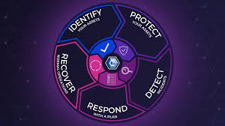
Risk Management Cycle in Cybersecurity
Risk Assessment
Risk Assessment & Analysis
Risk Mitigation (Control Implementation)
Risk Monitoring & Detection
Incident Response & Recovery

Slide 21
RISK ASSESSMENT
Recognize and document potential cybersecurity threats and vulnerabilities.
Conduct asset inventory (e.g., servers, applications, data).
Identify threats like malware, phishing, insider threats, or zero-day attacks.
Assess vulnerabilities using Vulnerability Assessment & Penetration Testing (VAPT).
Review compliance requirements (e.g., ISO 27001, NIST, GDPR).
Example: Detecting outdated software that could be exploited in a cyberattack.

Slide 22
Risk Assessment & Analysis
Evaluate the likelihood and impact of each risk.
Use a risk matrix (Low, Medium, High) to prioritize risks.
Analyze attack vectors (e.g., phishing emails, weak passwords, misconfigurations).
Assess financial, reputational, and operational consequences.
Example: A ransomware attack on a financial system is high risk due to severe financial and data loss impact.

Slide 23
Risk Mitigation (Control Implementation)
Apply security measures to reduce risk exposure.
Technical controls: Firewalls, endpoint security, MFA, encryption.
Administrative controls: Policies, training, incident response plans.
Physical controls: Secure access to server rooms, CCTV monitoring.
Defense-in-depth: Layered security (e.g., combining firewall, antivirus, and IAM).
Deploying multi-factor authentication (MFA) to prevent unauthorized logins.

Slide 24
Risk Monitoring & Detection
Continuously track security events to detect emerging threats.
Use SIEM (Security Information and Event Management) for real-time monitoring.
Conduct periodic security audits and log reviews.
Set up intrusion detection systems (IDS) to detect malicious activity.
Example: Detecting suspicious login attempts from unusual locations in real-time.

Slide 25
Incident Response & Recovery
Quickly respond to and recover from security incidents.
Incident response plan (IRP): Steps to contain, eradicate, and recover.
Business Continuity & Disaster Recovery (BC/DR): Backup and restore critical data.
Post-incident analysis: Learning from incidents to improve security posture.
Example: After a ransomware attack, restoring systems from secure backups.

Slide 26
Risk Review & Continuous Improvement
Regularly update the risk management strategy to address new threats.
Conduct periodic risk reassessments.
Update policies based on lessons learned from incidents.
Ensure compliance with new regulatory requirements.
Example: Updating firewall rules after identifying new attack patterns.

Slide 27
RISK MANAGEMENT FRamework
ISO 27001 & NIST

Slide 28
LAB 2: AWS Virtual Machine
https://aws.amazon.com

Slide 29
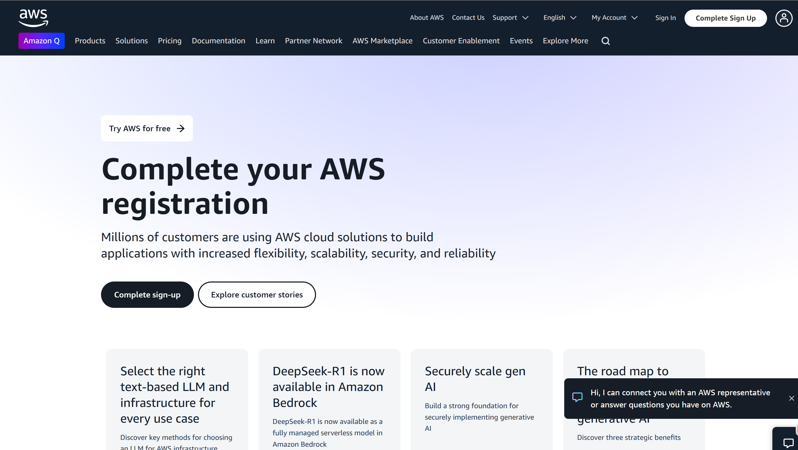
CREATE AN AWS ACCOUNT

Slide 30
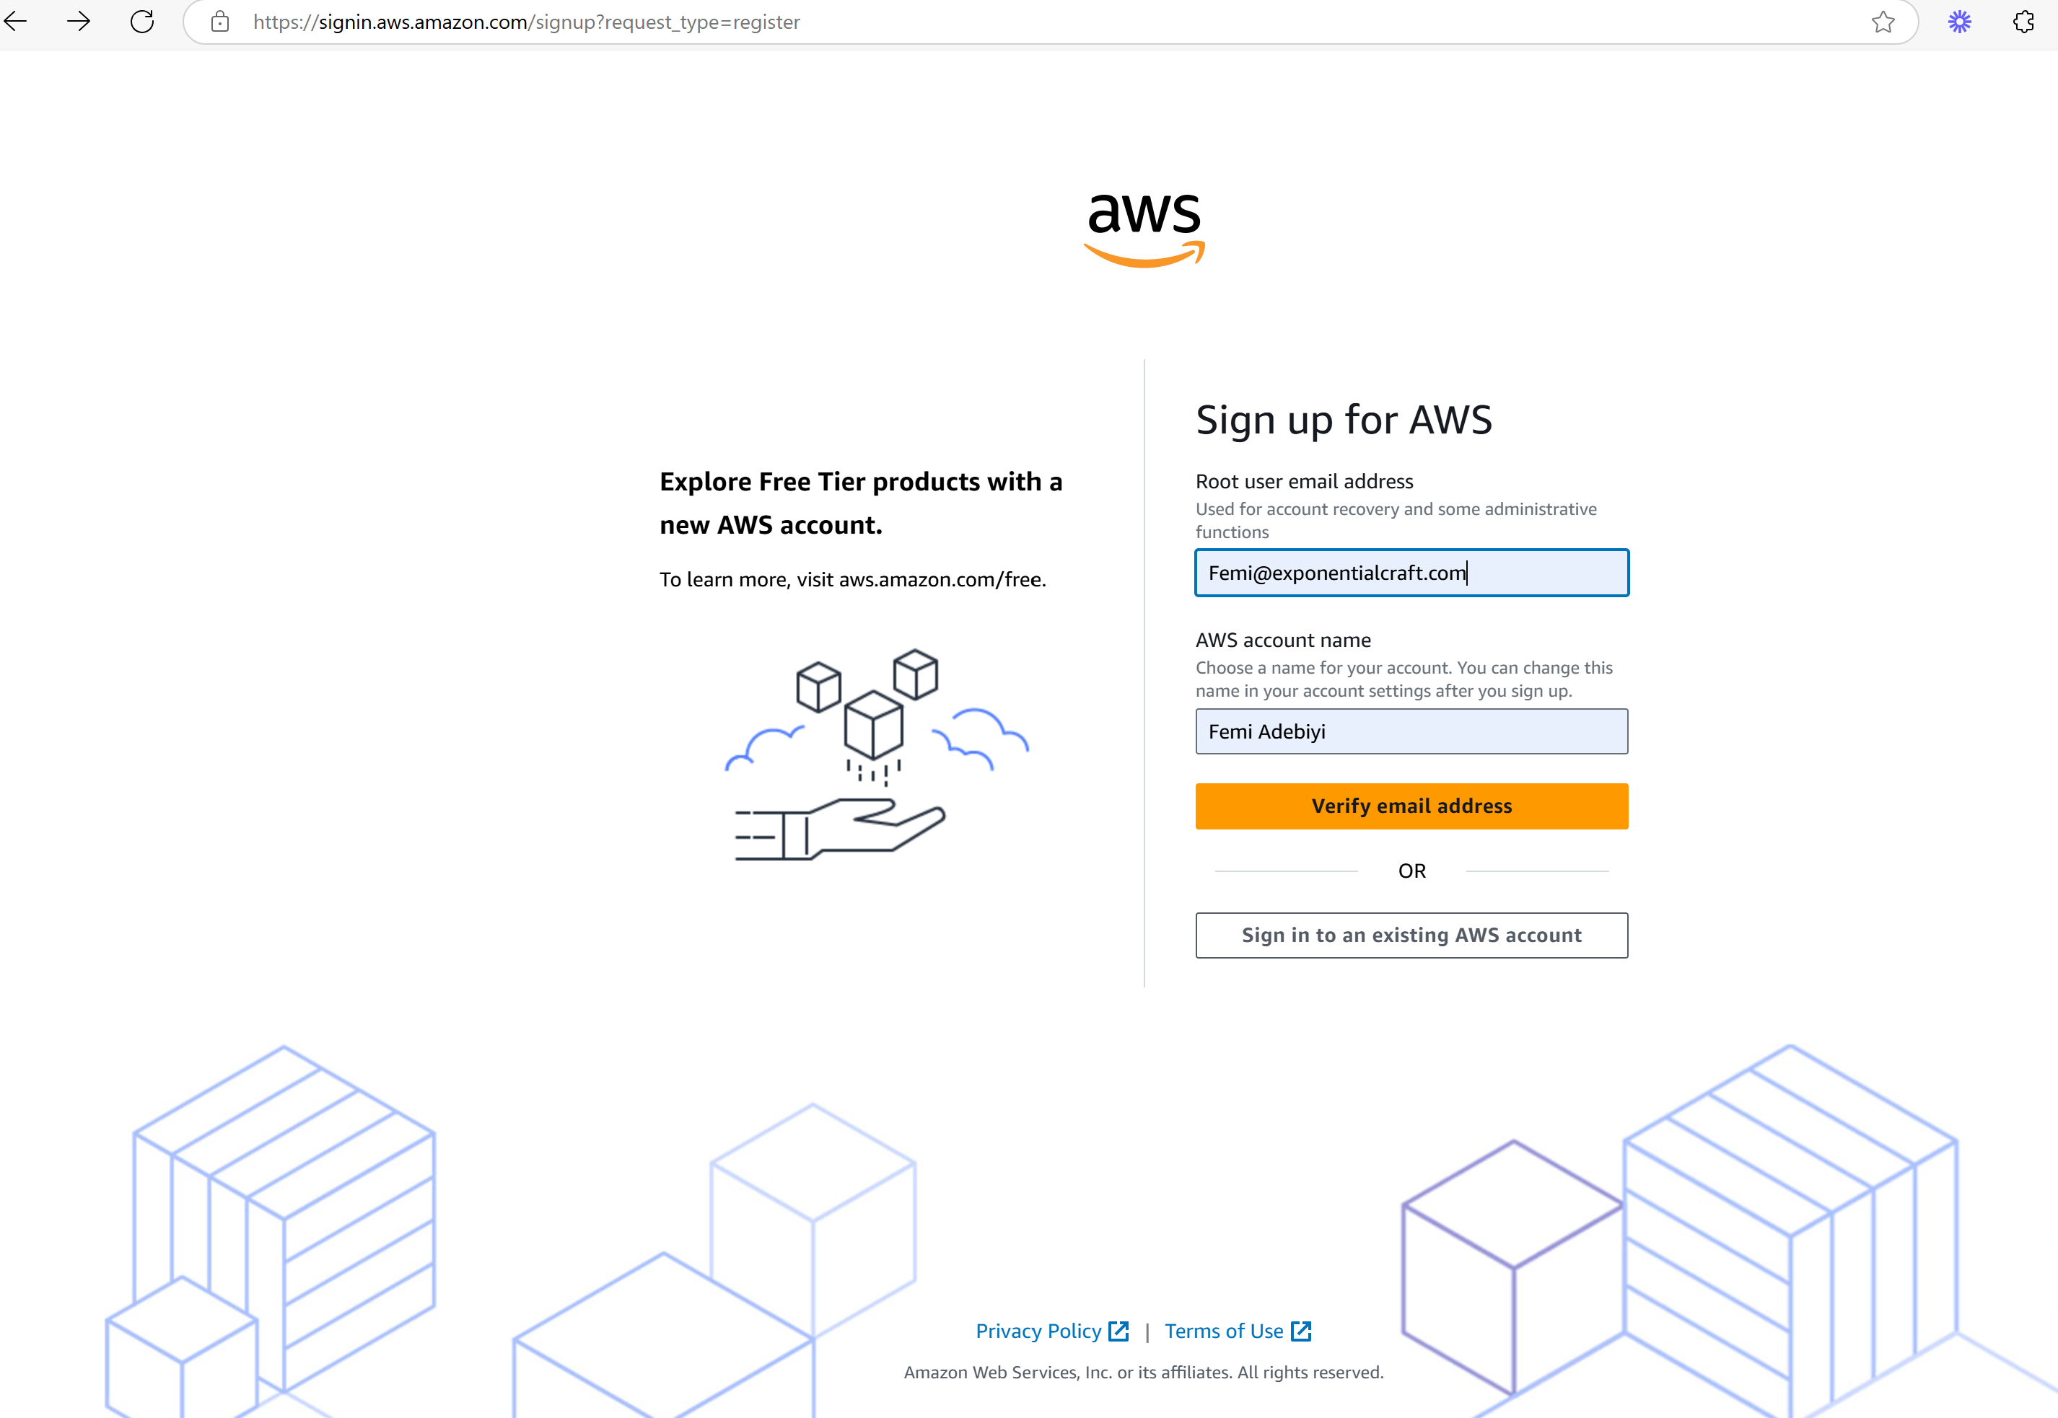
PROCEED TO SIGN UP

Slide 31
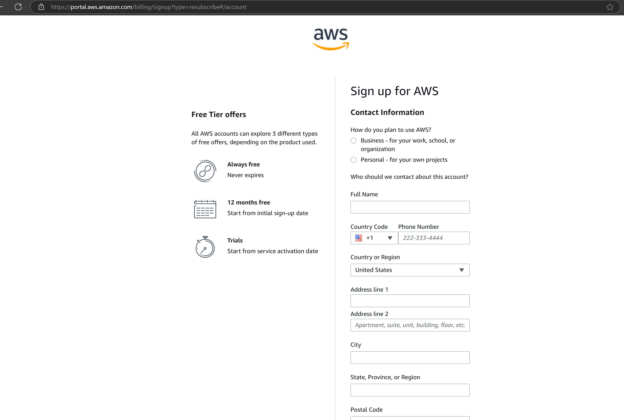
Proceed to fill your contact information

Slide 32
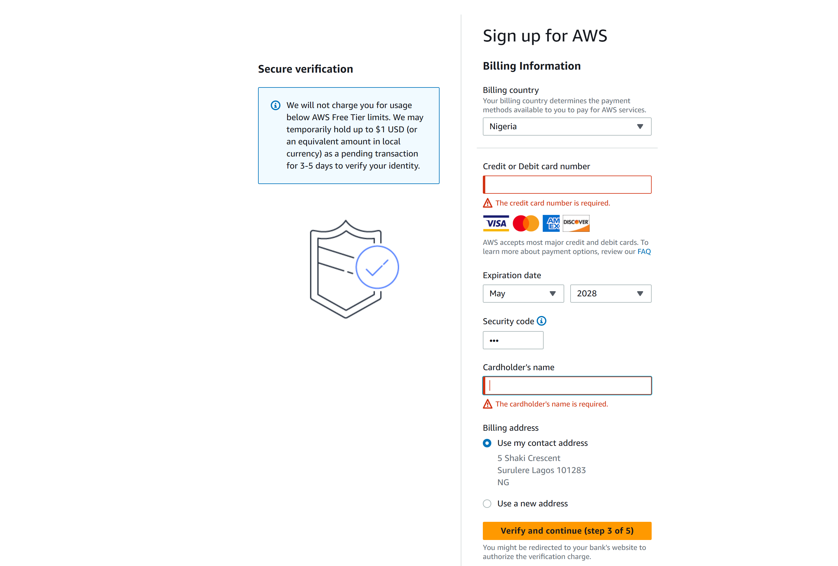
Complete the billing section – NO CHARGES APPLICABLE

Slide 33
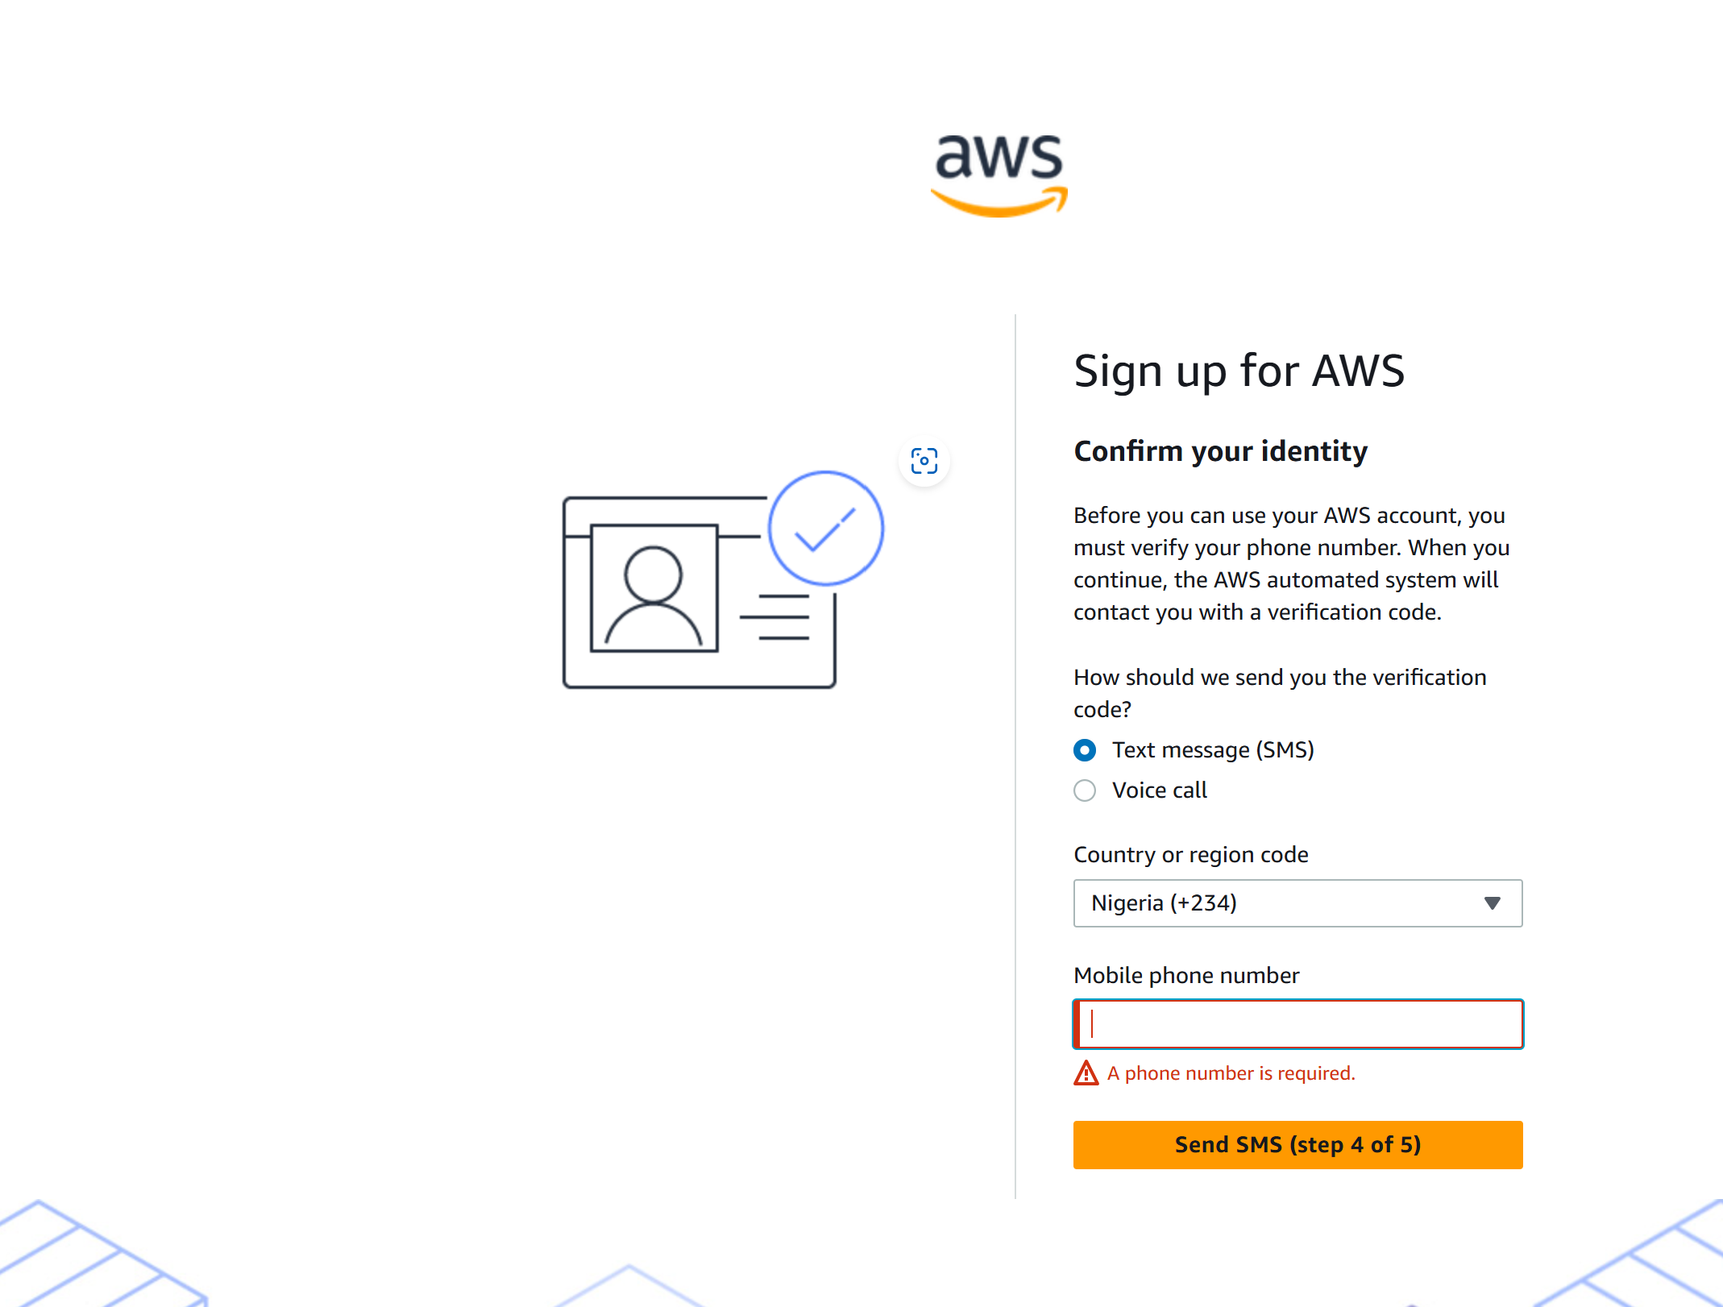
PROCEED TO CONFIRM YOUR IDENTITY

Slide 34
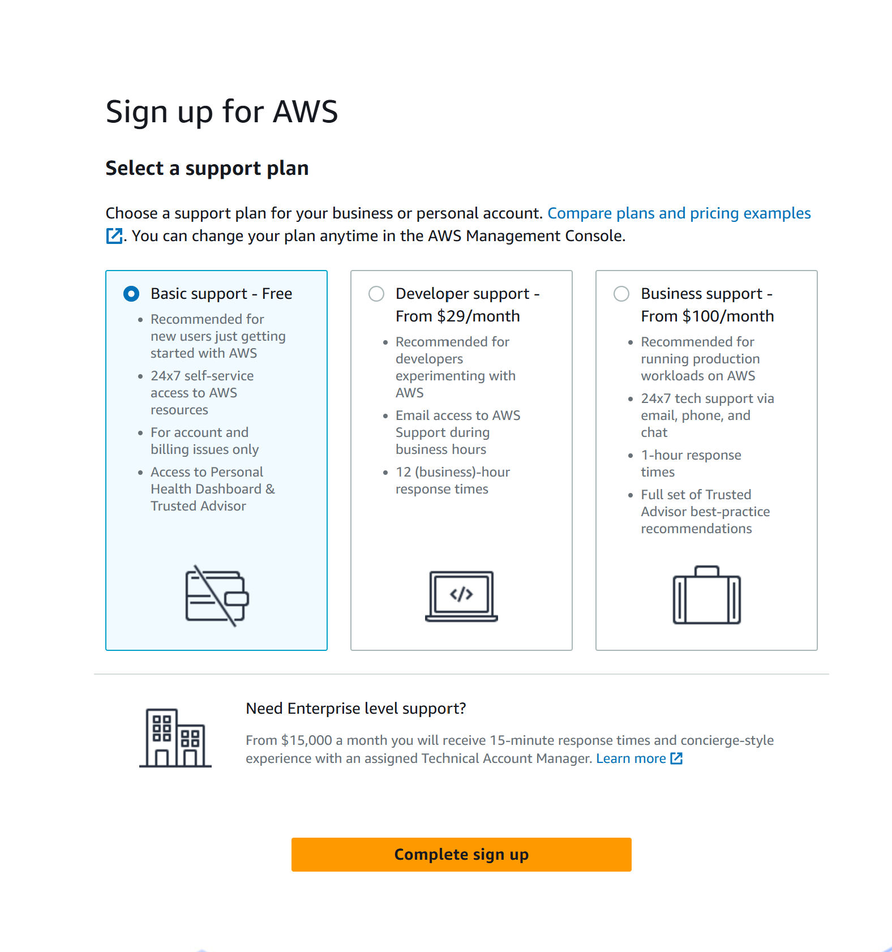
FINALLY – COMPLETE SIGNUP

Slide 35
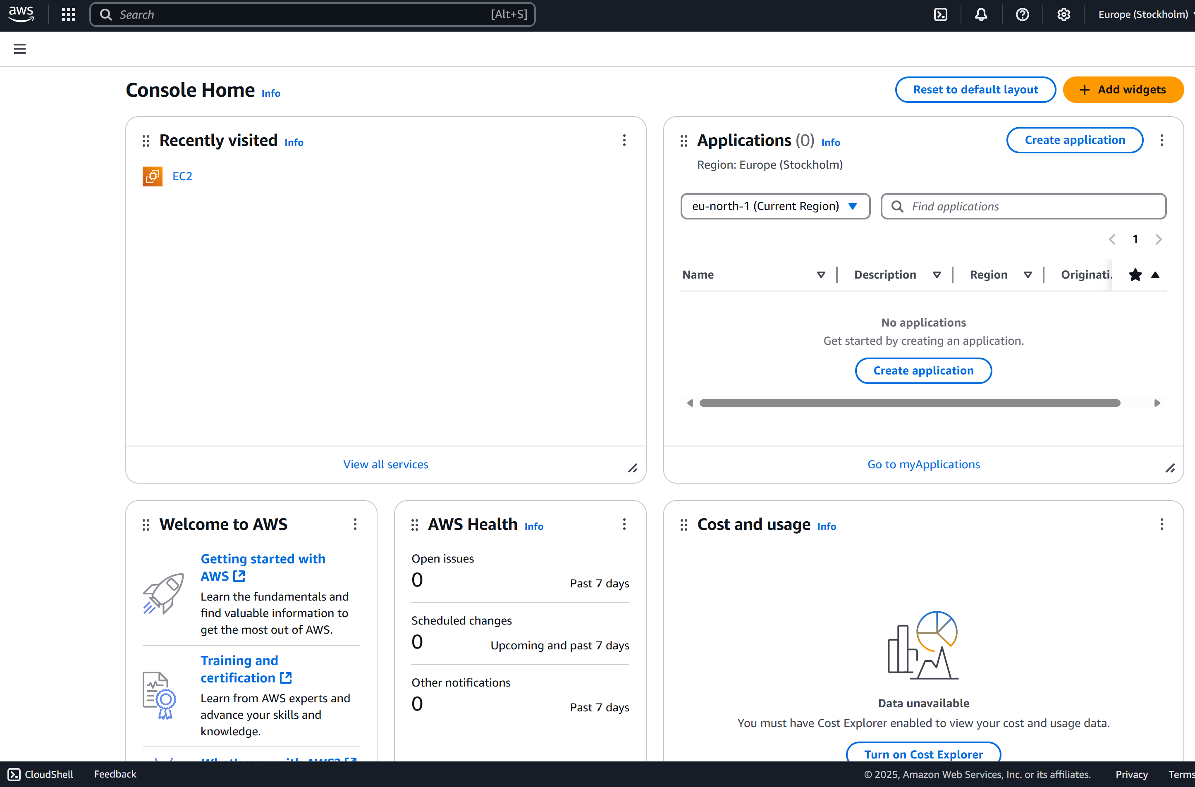
FROM THE MANAGEMENT CONSOLE CLICK ON EC2

